Slide 1
Sumo digital brief Presentation
Level 6
Group 03
Alixander Roden
Ionut Ciobanu

Slide 2
Brief summary
Single player game
Identify a genre that have a typical mechanic / set of mechanics
Remove a mechanic from the game
Substitute the mechanic with a new one that solves the resulted problems
Focus on a single mechanic

Slide 3
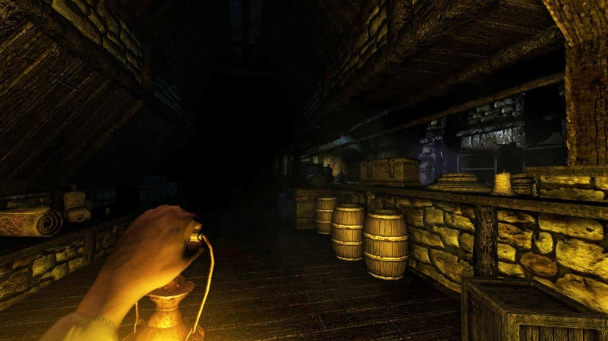
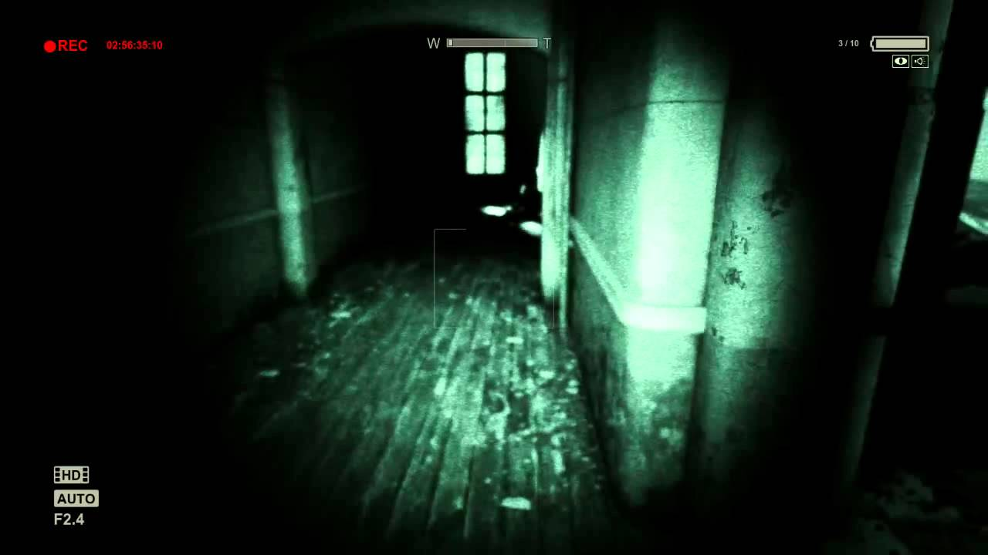
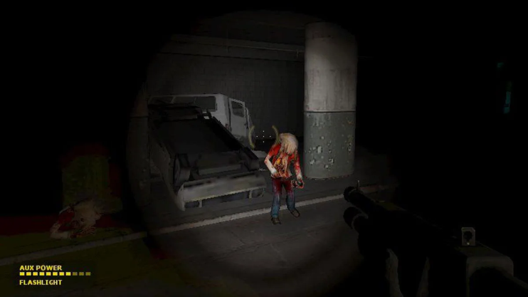
Brief response
Game genre: horror / survival horror (i.e. Amnesia)
Mechanic: torch / lantern / camera mechanic
Replaced with: Light ray reflection mechanic

Slide 4
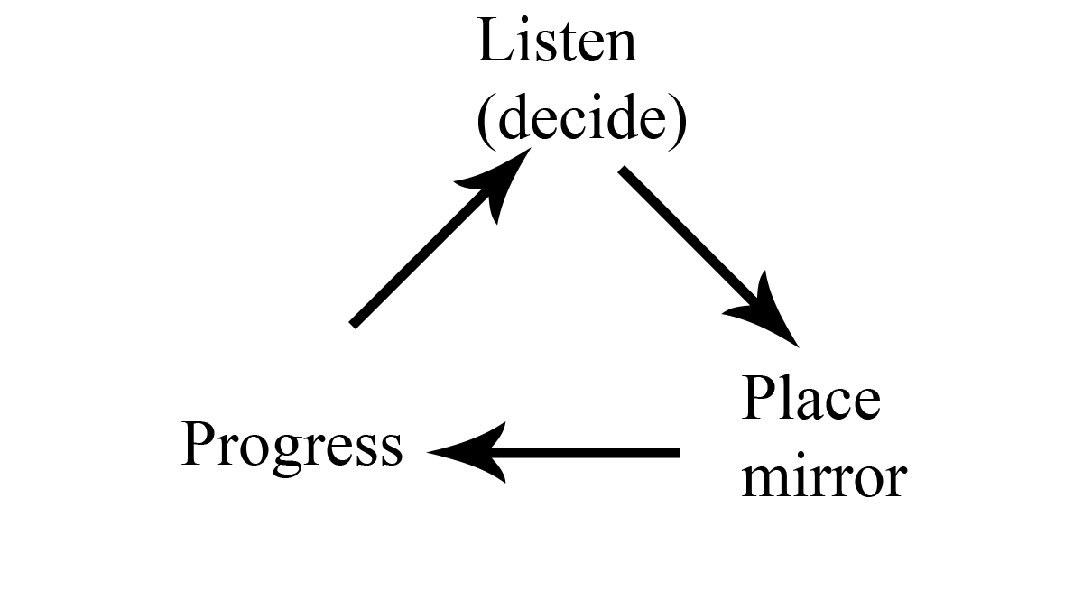
The game

Slide 5
Emotions
‘Sensation’
Fear:
Dark, atmospheric level design
Eerie audio cues
General fear of helplessness
Limited amount of mirrors
Confusion:
Maze-like level design
Misleading audio cues

Slide 6
Deliverables
A fully navigable and art complete maze-like map (level)
Ray reflect mechanic
Audio cues
Optimised mirrors controls
Polished experience
(‘Sanity’ like mechanic if necessary upon play-testing)

Slide 7
Thank you!
Any questions?

